Slide 1
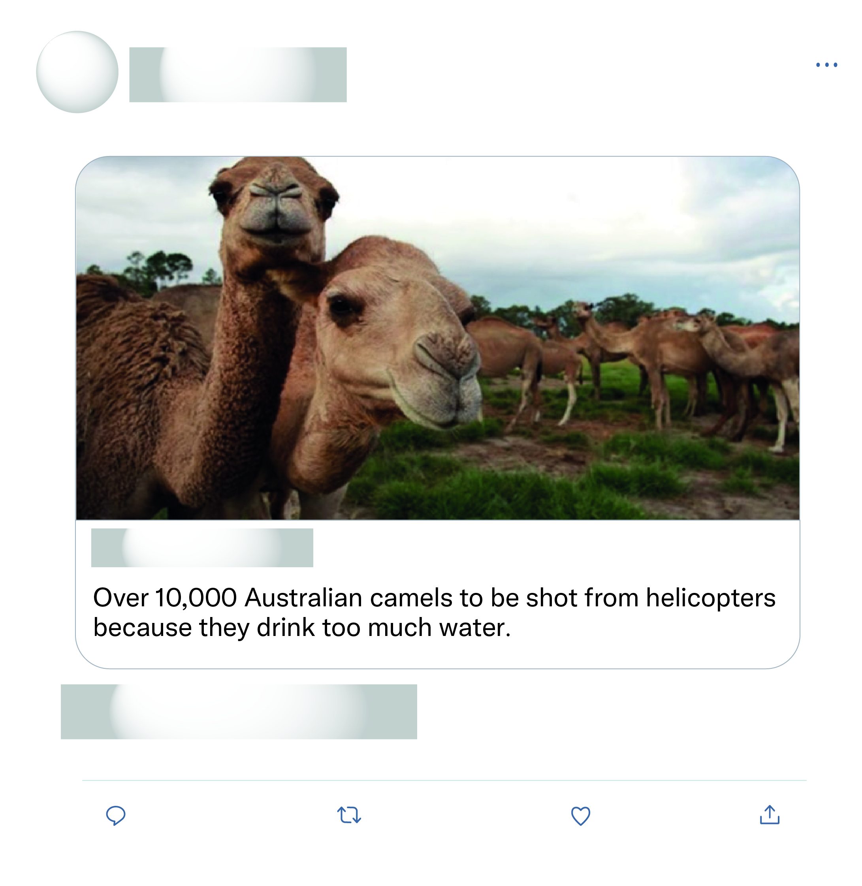








That's all the experts sat down and discussed as the solution wow what a productive move nothing else just killing more animals again after half a billion have died what a move.
This is just absolute nonsense!

Slide 2
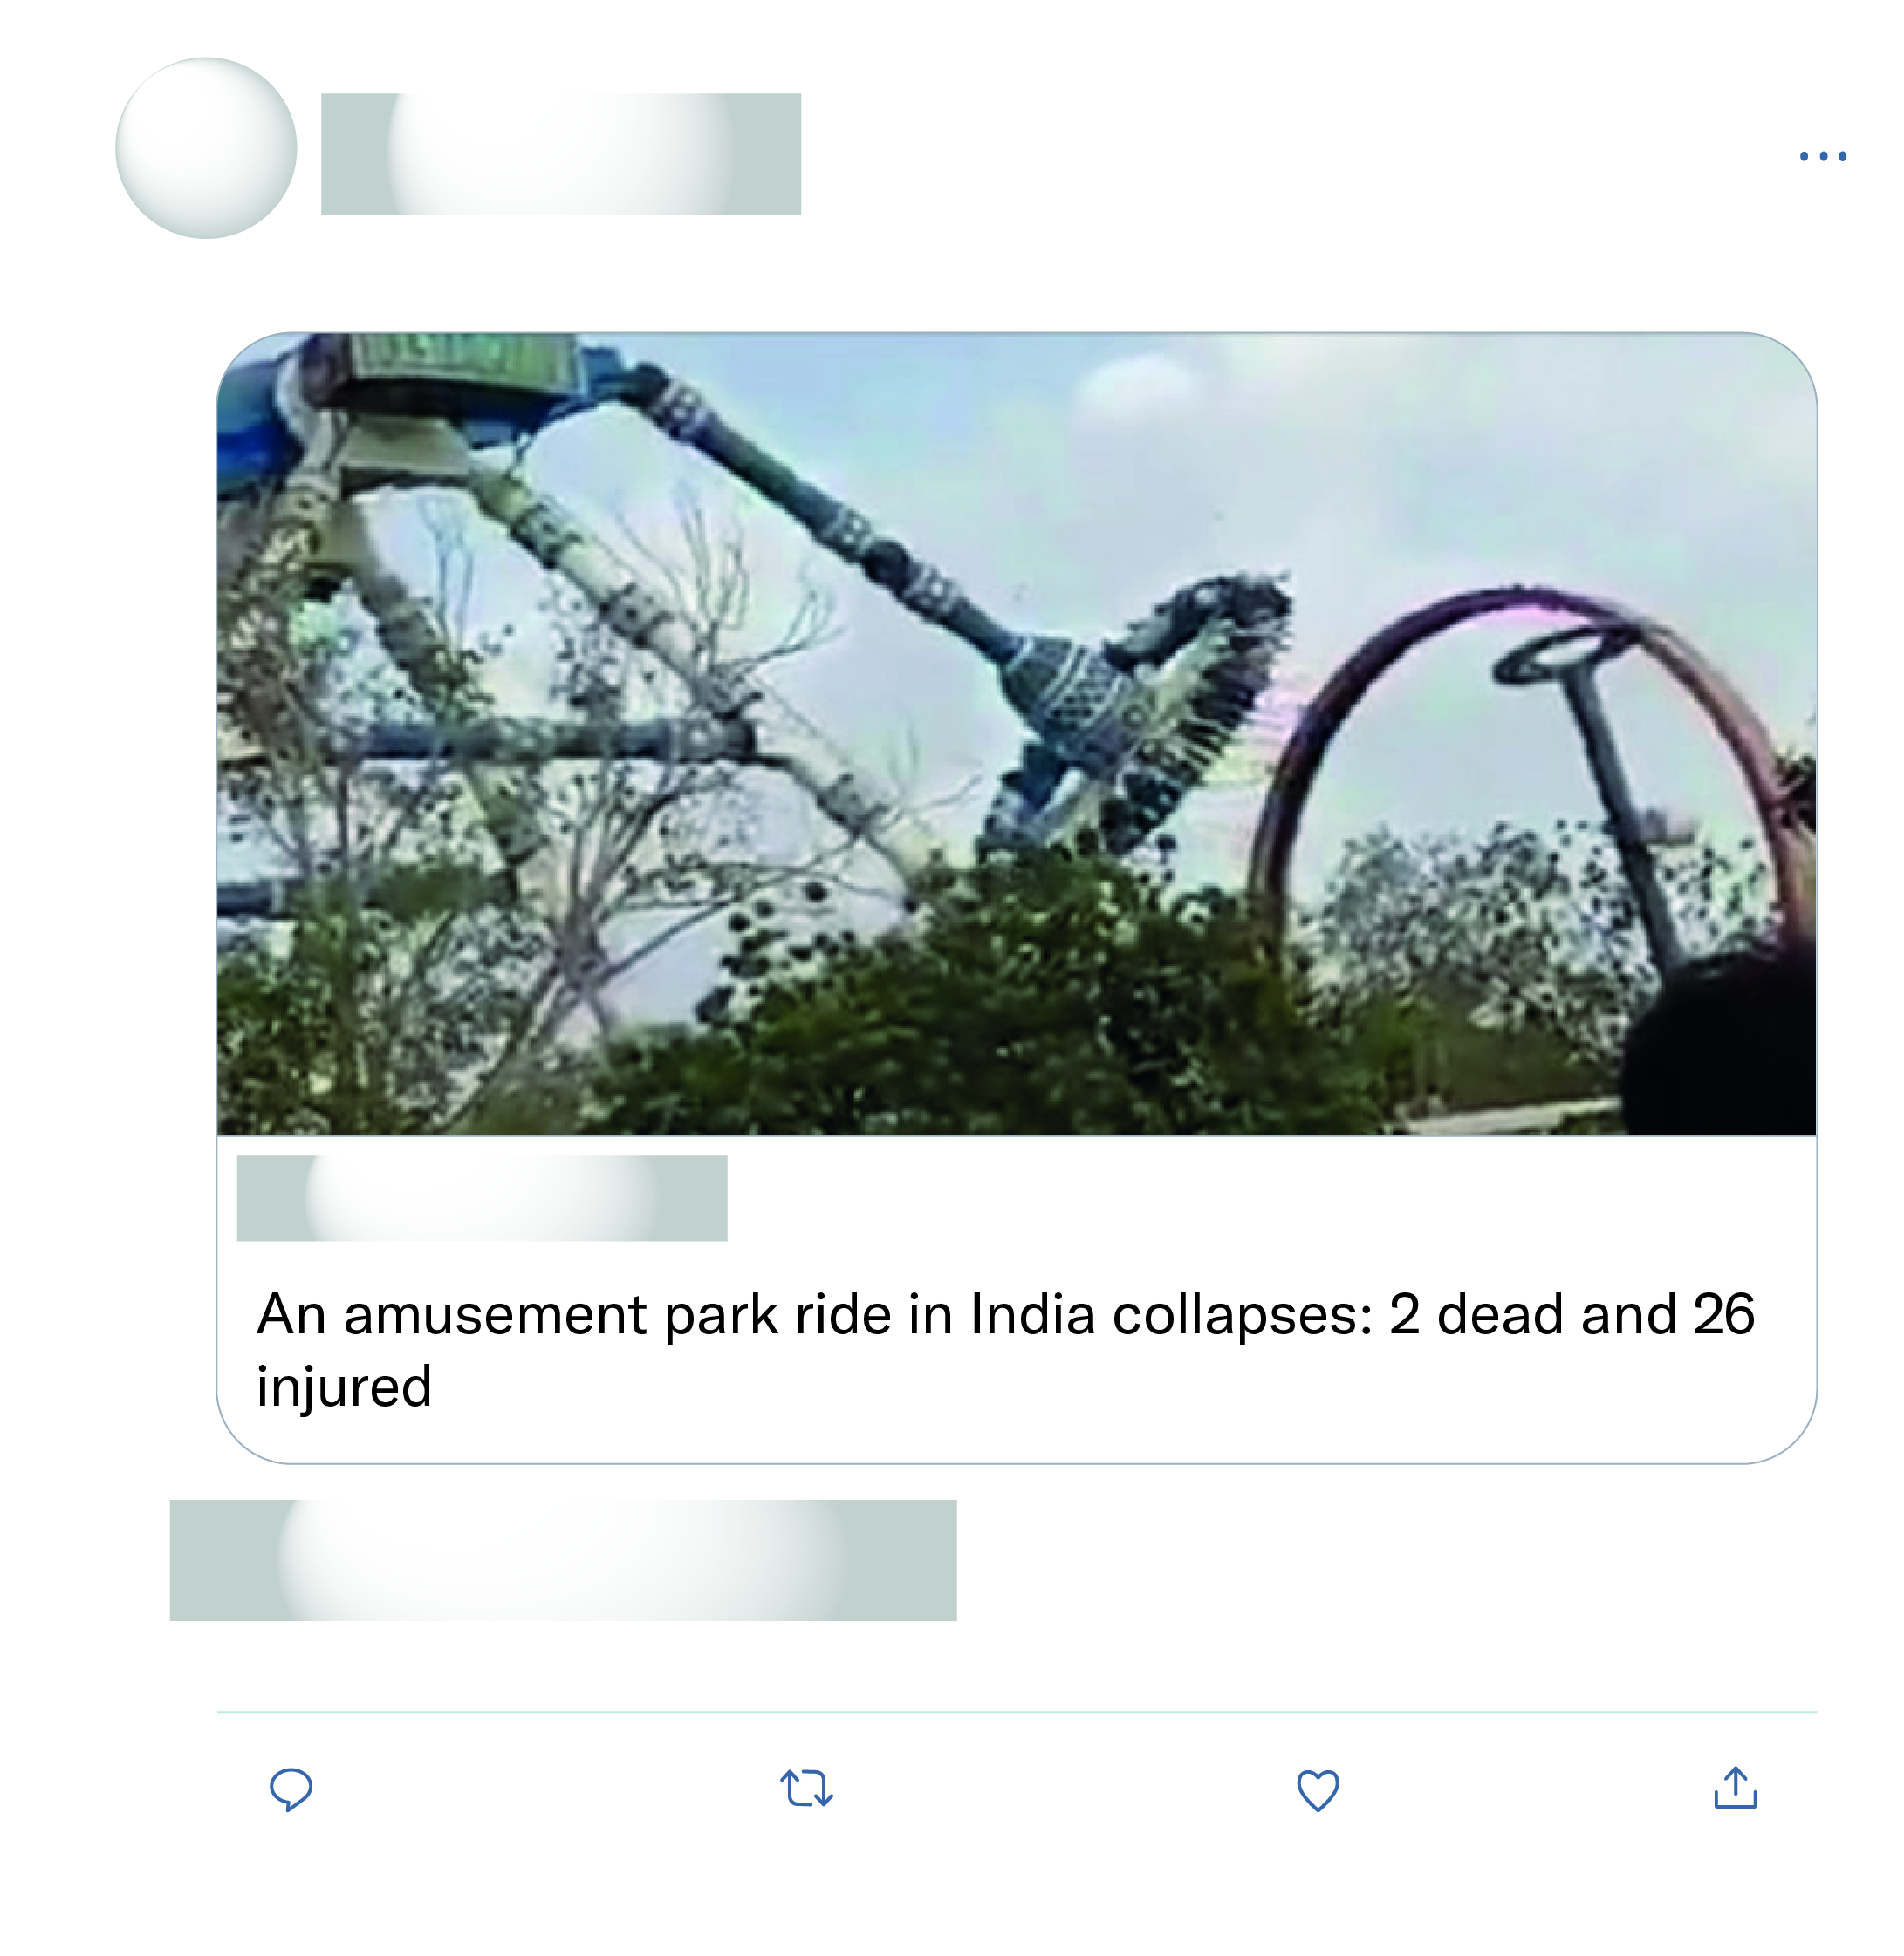
Misinformation. This is not India for sure.
So sad. RIP. Hope the injured get the best care and recover quickly. Whole place should be shut down for months until they find the cause and assign responsibility.
Fake. Poorly photoshopped visuals.
Photoshopped.

